Slide 1


Mustansiriayh University
College of Engineering
Computer Engineering Department
Optimization Problem Formulation
By: Thoalfeqar Gatea Jarullah, Master Degree Student
thoalfeqar.gatea.jarullah@uomustansiriyah.edu.iq

Slide 2
Introduction
In the real world, we often encounter problems that require minimizing or maximizing a certain value according to some constraints.
These problems are given as statements that include some information about what it is required to achieve and what constraints are imposed.
To turn these English expressions into Mathematical expressions, we can follow these general steps:
Identify the goal of the problem, which is called “the objective function”. What do we want to maximize or minimize?
Search for the constraints imposed on the objective function. What should be done while minimizing or maximizing the objective function?
Search for statements that tell you about the boundaries of each variable of the objective function. Are the variables required to be only positive, only negative, or should fall within a specific range?

Slide 3
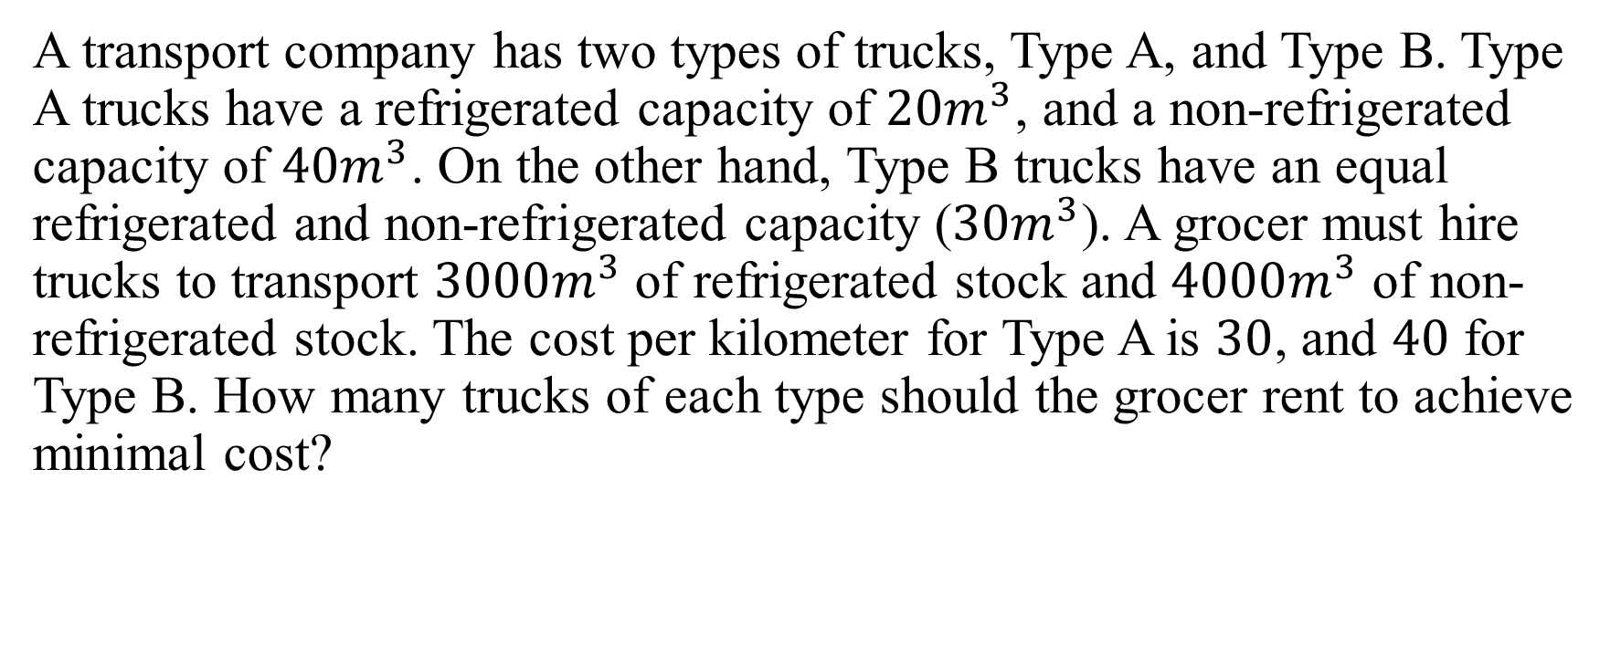
Problem 1
A transport company has two types of trucks, Type A, and Type B. Type A trucks have a refrigerated capacity of $20m^{3}$, and a non-refrigerated capacity of $40m^{3}$. On the other hand, Type B trucks have an equal refrigerated and non-refrigerated capacity ($30m^{3}$). A grocer must hire trucks to transport $3000m^{3}$ of refrigerated stock and $4000m^{3}$ of non-refrigerated stock. The cost per kilometer for Type A is $30$, and $40$ for Type B. How many trucks of each type should the grocer rent to achieve minimal cost?

Slide 4
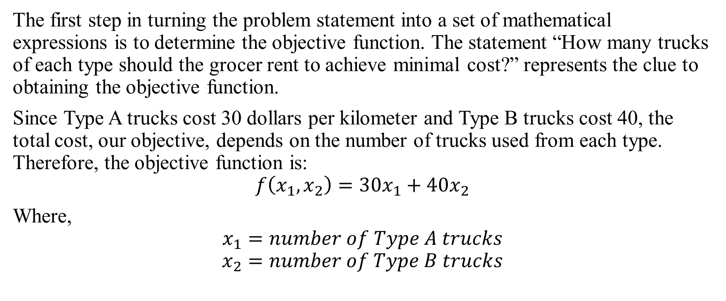
Problem 1
The first step in turning the problem statement into a set of mathematical expressions is to determine the objective function. The statement “How many trucks of each type should the grocer rent to achieve minimal cost?” represents the clue to obtaining the objective function.
Since Type A trucks cost 30 dollars per kilometer and Type B trucks cost 40, the total cost, our objective, depends on the number of trucks used from each type. Therefore, the objective function is:
$$f\left(x_{1}, x_{2}\right)=30x_{1}+40x_{2}$$
Where,
$$x_{1}=number of Type A trucks$$
$$x_{2}=number of Type B trucks$$

Slide 5
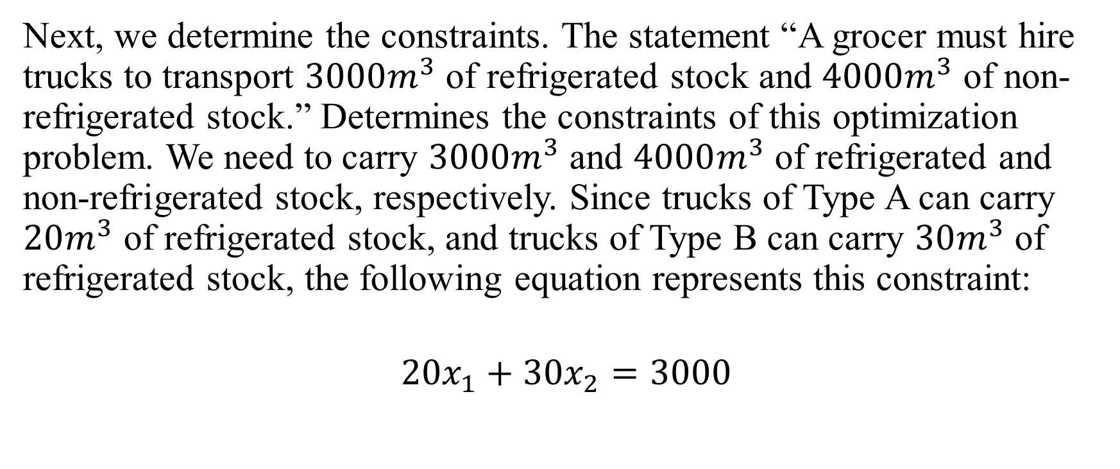
Problem 1
Next, we determine the constraints. The statement “A grocer must hire trucks to transport $3000m^{3}$ of refrigerated stock and $4000m^{3}$ of non-refrigerated stock.” Determines the constraints of this optimization problem. We need to carry $3000m^{3}$ and $4000m^{3}$ of refrigerated and non-refrigerated stock, respectively. Since trucks of Type A can carry $20m^{3}$ of refrigerated stock, and trucks of Type B can carry $30m^{3}$ of refrigerated stock, the following equation represents this constraint:
$$20x_{1}+30x_{2}=3000$$

Slide 6
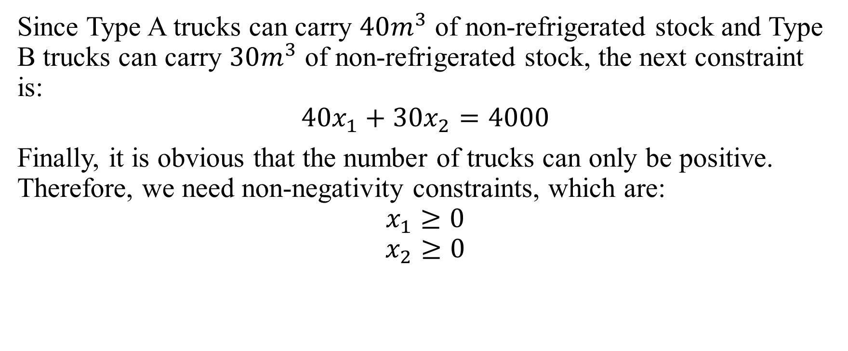
Problem 1
Since Type A trucks can carry $40m^{3}$ of non-refrigerated stock and Type B trucks can carry $30m^{3}$ of non-refrigerated stock, the next constraint is:
$$40x_{1}+30x_{2}=4000$$
Finally, it is obvious that the number of trucks can only be positive. Therefore, we need non-negativity constraints, which are:
$$x_{1}≥0$$
$$x_{2}≥0$$

Slide 7
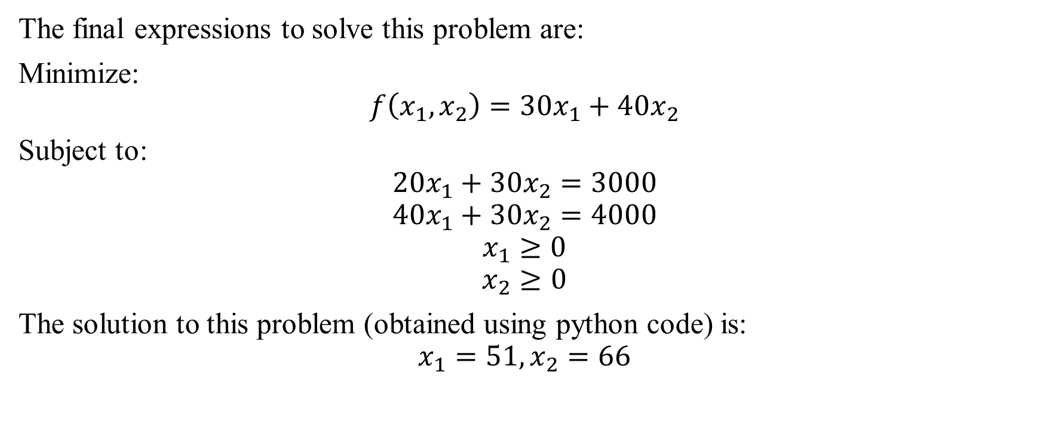
Problem 1
The final expressions to solve this problem are:
Minimize:
$$f\left(x_{1},x_{2}\right)=30x_{1}+40x_{2}$$
Subject to:
$$20x_{1}+30x_{2}=3000$$
$$40x_{1}+30x_{2}=4000$$
$$x_{1}≥0$$
$$x_{2}≥0$$
The solution to this problem (obtained using python code) is:
$$x_{1}=51, x_{2}=66$$

Slide 8
Problem 2
A fruit juice company makes two special drinks by blending apple and pineapple juices. The profit per liter is $0.60 for the first drink and $0.50 for the second drink. The table shows the portions of apple and pineapple juice in each drink.
There are 1000 liters of apple juice and 1500 liters of pineapple juice available. Use the simplex method to find the numbers of liters of each drink that should be produced in order to maximize the profit.
Ingredients | First drink | Second Drink
Apple Juice | 30% | 60%
Pineapple Juice | 70% | 40%

Slide 9
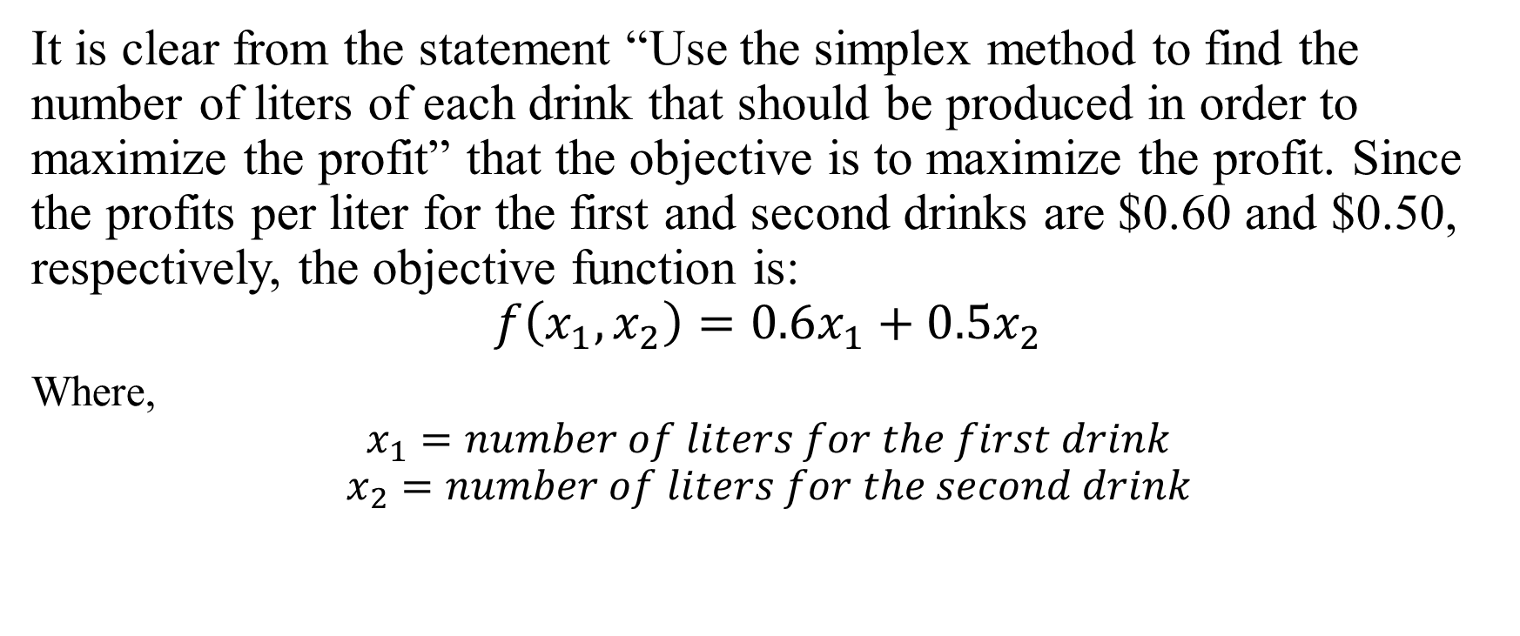
Problem 2
It is clear from the statement “Use the simplex method to find the number of liters of each drink that should be produced in order to maximize the profit” that the objective is to maximize the profit. Since the profits per liter for the first and second drinks are $0.60 and $0.50, respectively, the objective function is:
$$f\left(x_{1}, x_{2}\right)=0.6x_{1}+0.5x_{2}$$
Where,
$$x_{1}=number of liters for the first drink$$
$$x_{2}=number of liters for the second drink$$

Slide 10
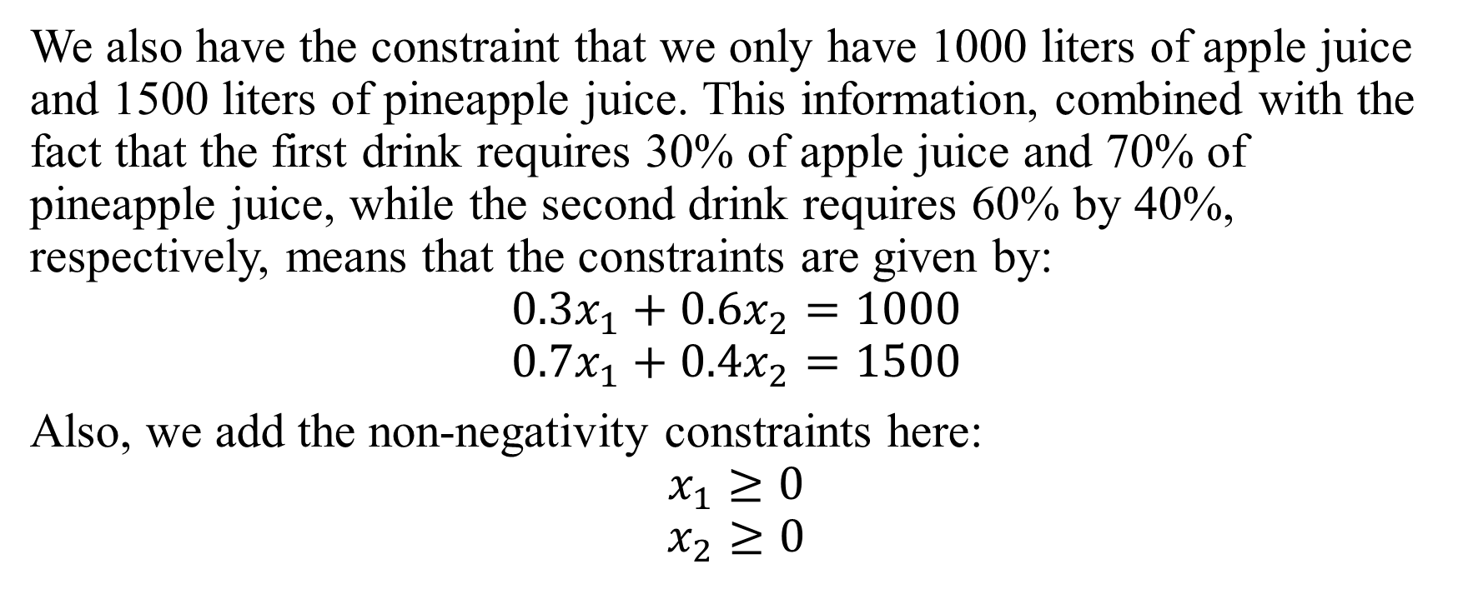
Problem 2
We also have the constraint that we only have 1000 liters of apple juice and 1500 liters of pineapple juice. This information, combined with the fact that the first drink requires 30% of apple juice and 70% of pineapple juice, while the second drink requires 60% by 40%, respectively, means that the constraints are given by:
$$0.3x_{1}+0.6x_{2}=1000$$
$$0.7x_{1}+0.4x_{2}=1500$$
Also, we add the non-negativity constraints here:
$$x_{1}≥0$$
$$x_{2}≥0$$

Slide 11
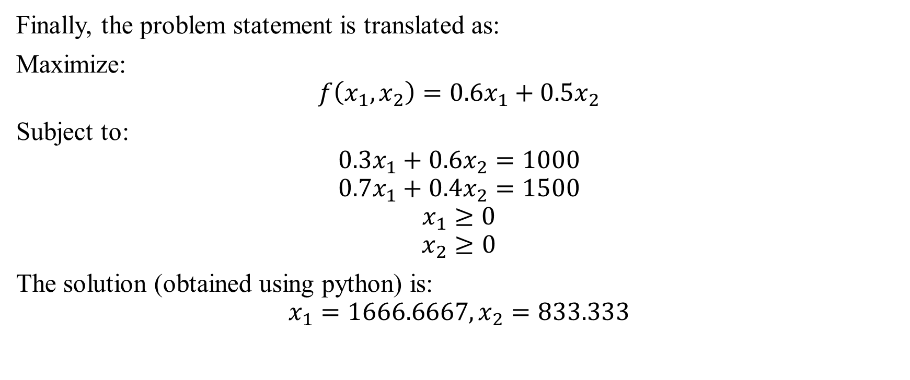
Problem 2
Finally, the problem statement is translated as:
Maximize:
$$f\left(x_{1}, x_{2}\right)=0.6x_{1}+0.5x_{2}$$
Subject to:
$$0.3x_{1}+0.6x_{2}=1000$$
$$0.7x_{1}+0.4x_{2}=1500$$
$$x_{1}≥0$$
$$x_{2}≥0$$
The solution (obtained using python) is:
$$x_{1}=1666.6667, x_{2}=833.333$$

Slide 12
Problem 3
A store wants to liquidate 200 shirts and 100 pairs of pants from last season. They have decided to put together two offers, A and B. Offer A is a package of one shirt and a pair of pants which will sell for 30. Offer B is a package of three shirts and a pair of pants, which will sell for 50. The store does not want to sell less than 20 packages of offer A and less than 10 of offer B. How many packages of each do they have to deal to maximize the money generated from the promotion?

Slide 13
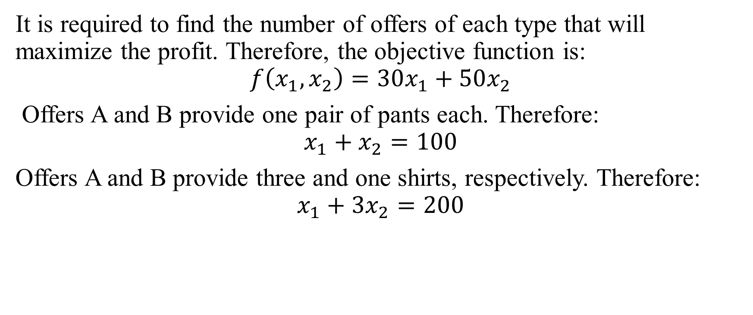
Problem 3
It is required to find the number of offers of each type that will maximize the profit. Therefore, the objective function is:
$$f\left(x_{1}, x_{2}\right)=30x_{1}+50x_{2}$$
Offers A and B provide one pair of pants each. Therefore:
$$x_{1}+x_{2}=100$$
Offers A and B provide three and one shirts, respectively. Therefore:
$$x_{1}+3x_{2}=200$$

Slide 14
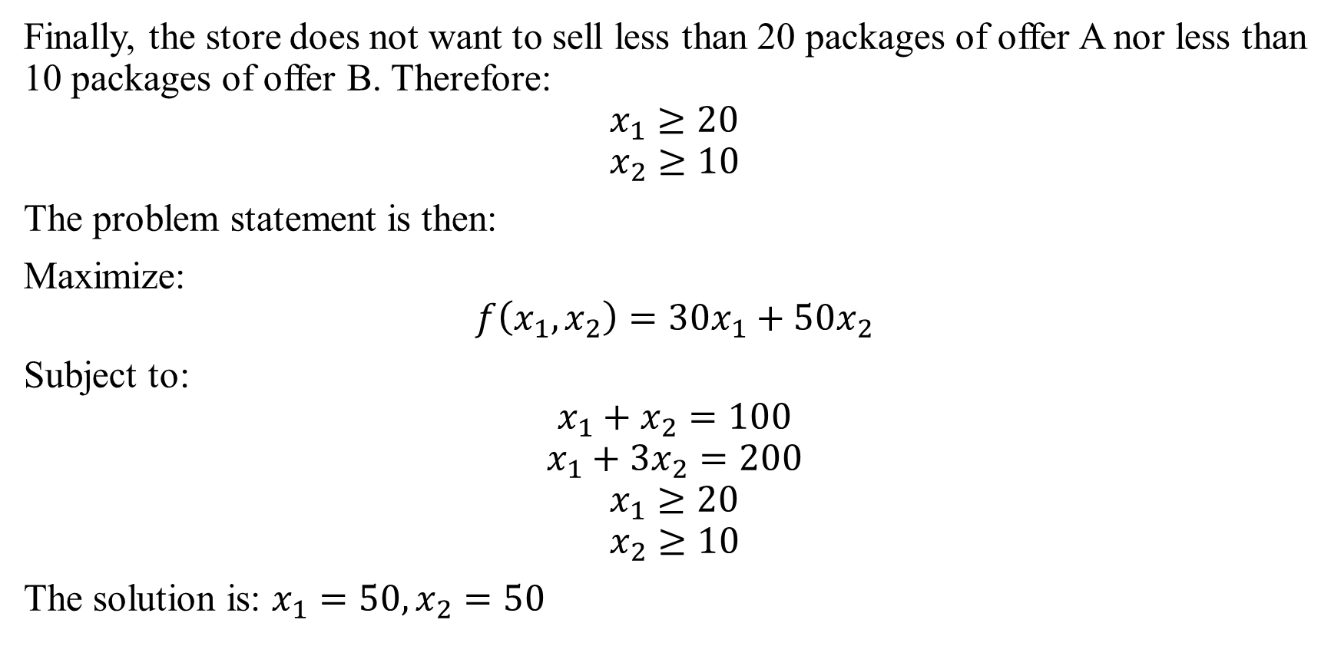
Problem 3
Finally, the store does not want to sell less than 20 packages of offer A nor less than 10 packages of offer B. Therefore:
$$x_{1}≥20$$
$$x_{2}≥10$$
The problem statement is then:
Maximize:
$$f\left(x_{1}, x_{2}\right)=30x_{1}+50x_{2}$$
Subject to:
$$x_{1}+x_{2}=100$$
$$x_{1}+3x_{2}=200$$
$$x_{1}≥20$$
$$x_{2}≥10$$
The solution is: $x_{1}=50, x_{2}=50$

Slide 15
Problem 4
The advertising alternatives for a company include television, radio, and newspaper advertisements. The costs and estimates for audience coverage are given in the following table:
The local newspaper limits the number of weekly advertisements from a single company to ten. Moreover, in order to balance advertising among the three types of media, no more than half of the total number of advertisements should occur on the radio, and at least 10% should occur on television. The weekly advertising budget is $18,200. How many advertisements should be run in each of the three types of media to maximize the total audience?
 | Television | Newspaper | Radio
Cost per advertisement | $2000 | $600 | $300
Audience per advertisement | 100,000 | 40,000 | 18,000

Slide 16
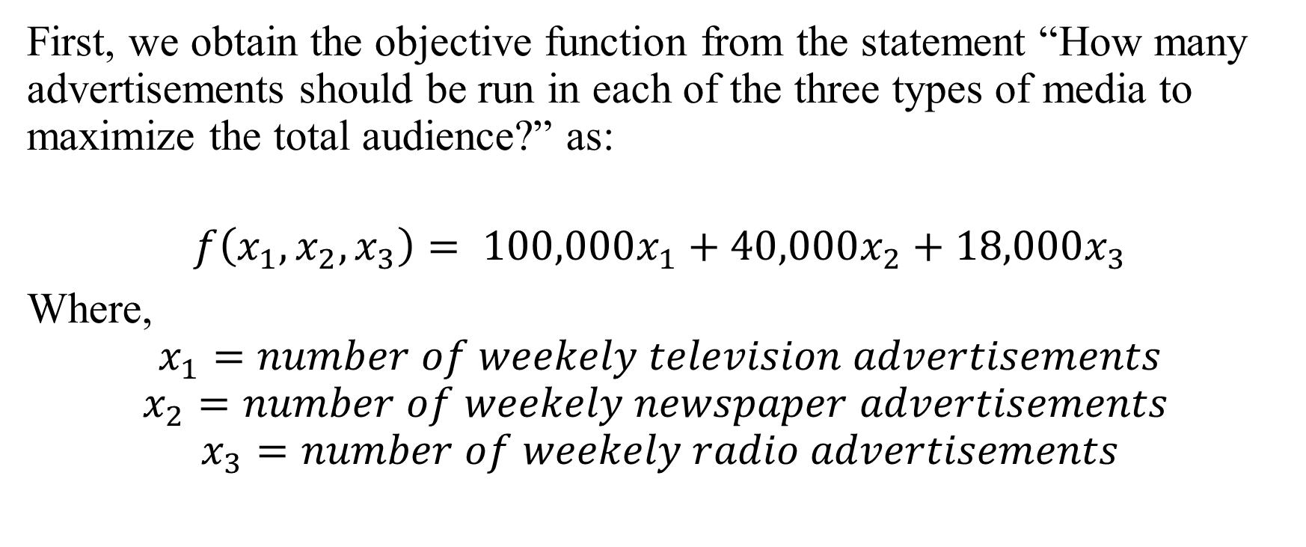
Problem 4
First, we obtain the objective function from the statement “How many advertisements should be run in each of the three types of media to maximize the total audience?” as:
$$f\left(x_{1},x_{2},x_{3}\right)= 100,000x_{1}+40,000x_{2}+18,000x_{3}$$
Where,
$$x_{1}=number of weekely television advertisements$$
$$x_{2}=number of weekely newspaper advertisements$$
$$x_{3}=number of weekely radio advertisements$$

Slide 17
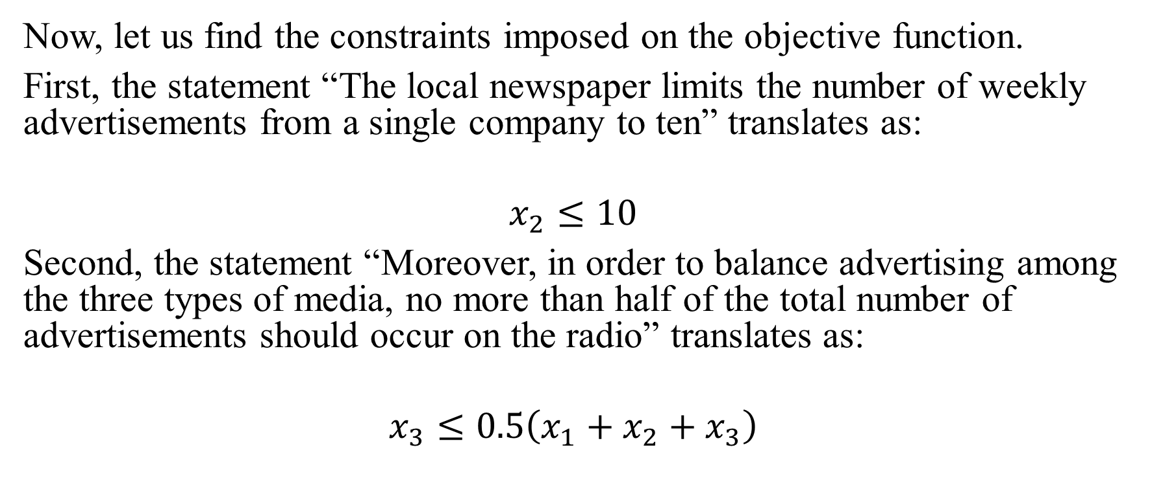
Problem 4
Now, let us find the constraints imposed on the objective function.
First, the statement “The local newspaper limits the number of weekly advertisements from a single company to ten” translates as:
$$x_{2}≤10$$
Second, the statement “Moreover, in order to balance advertising among the three types of media, no more than half of the total number of advertisements should occur on the radio” translates as:
$$x_{3}≤0.5\left(x_{1}+x_{2}+x_{3}\right)$$

Slide 18
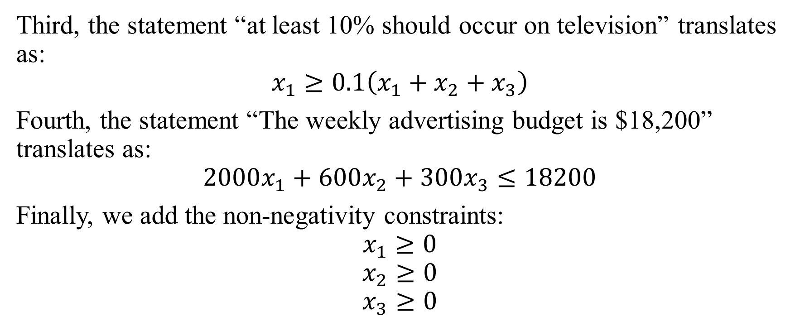
Problem 4
Third, the statement “at least 10% should occur on television” translates as:
$$x_{1}≥0.1\left(x_{1}+x_{2}+x_{3}\right)$$
Fourth, the statement “The weekly advertising budget is $18,200” translates as:
$$2000x_{1}+600x_{2}+300x_{3}≤18200$$
Finally, we add the non-negativity constraints:
$$x_{1}≥0$$
$$x_{2}≥0$$
$$x_{3}≥0$$

Slide 19
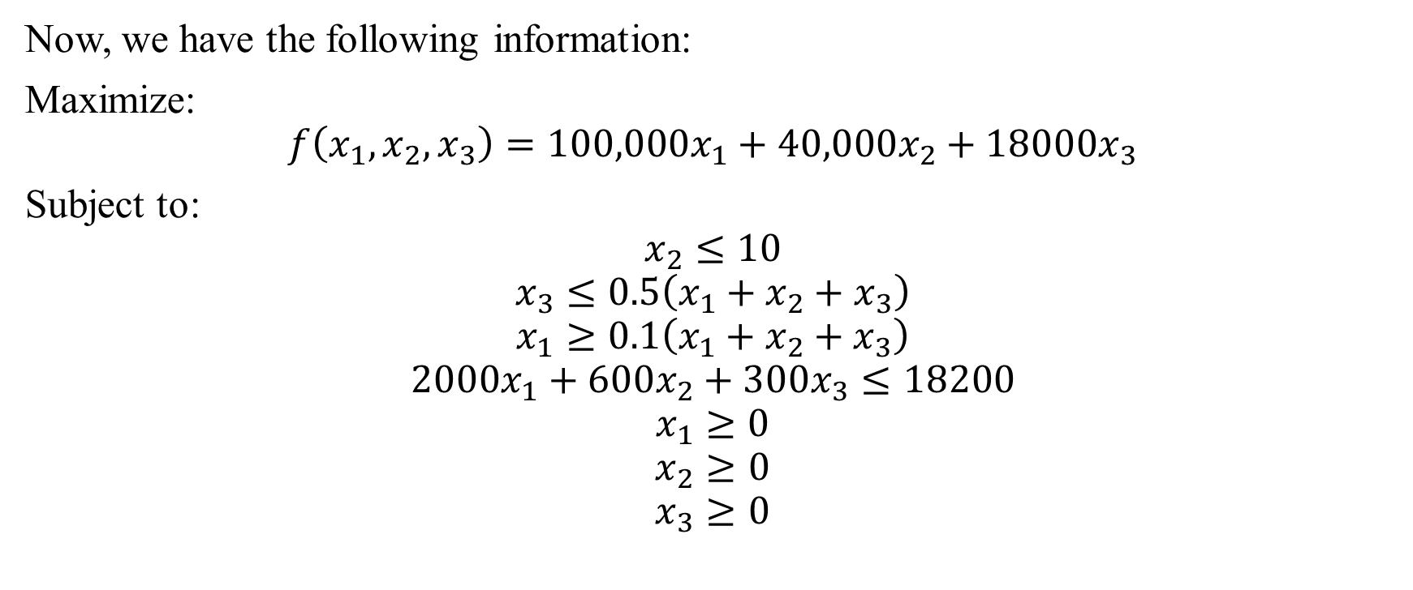
Problem 4
Now, we have the following information:
Maximize:
$$f\left(x_{1}, x_{2}, x_{3}\right)=100,000x_{1}+40,000x_{2}+18000x_{3}$$
Subject to:
$$x_{2}≤10$$
$$x_{3}≤0.5\left(x_{1}+x_{2}+x_{3}\right)$$
$$x_{1}≥0.1\left(x_{1}+x_{2}+x_{3}\right)$$
$$2000x_{1}+600x_{2}+300x_{3}≤18200$$
$$x_{1}≥0$$
$$x_{2}≥0$$
$$x_{3}≥0$$

Slide 20
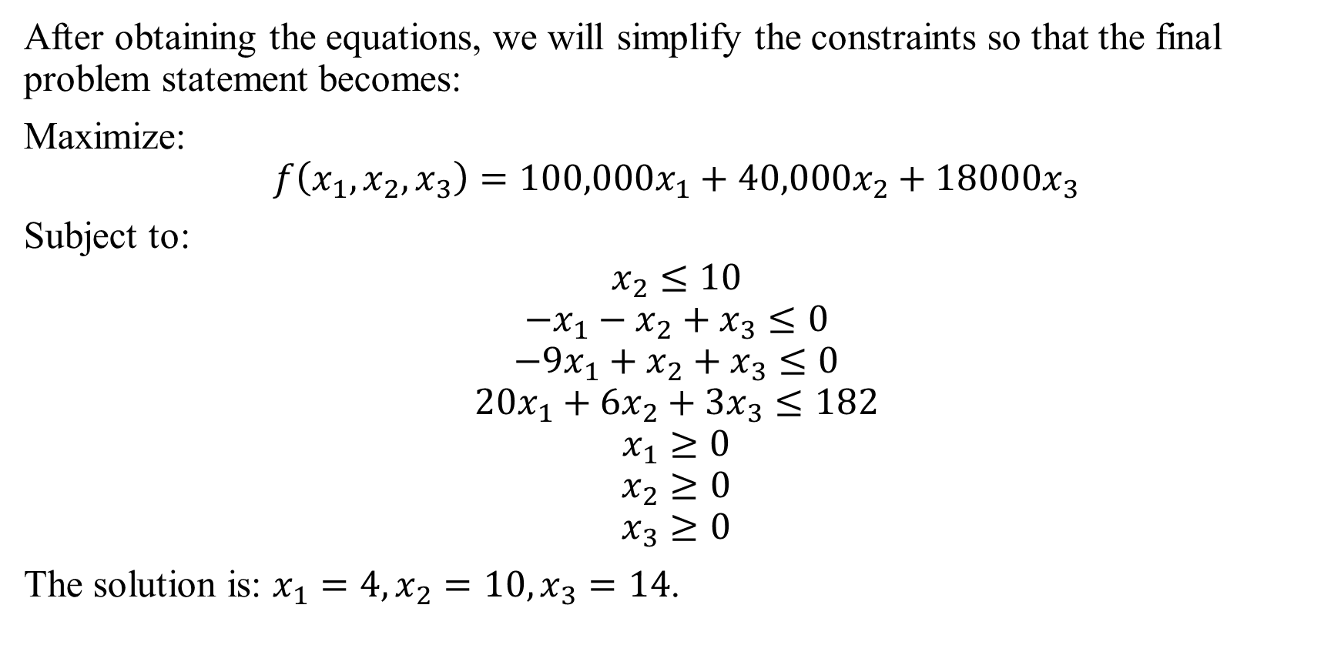
Problem 4
After obtaining the equations, we will simplify the constraints so that the final problem statement becomes:
Maximize:
$$f\left(x_{1}, x_{2}, x_{3}\right)=100,000x_{1}+40,000x_{2}+18000x_{3}$$
Subject to:
$$x_{2}≤10$$
$$−x_{1}−x_{2}+x_{3}≤0$$
$$−9x_{1}+x_{2}+x_{3}≤0$$
$$20x_{1}+6x_{2}+3x_{3}≤182$$
$$x_{1}≥0$$
$$x_{2}≥0$$
$$x_{3}≥0$$
The solution is: $x_{1}=4, x_{2}=10, x_{3}=14$.

Slide 21
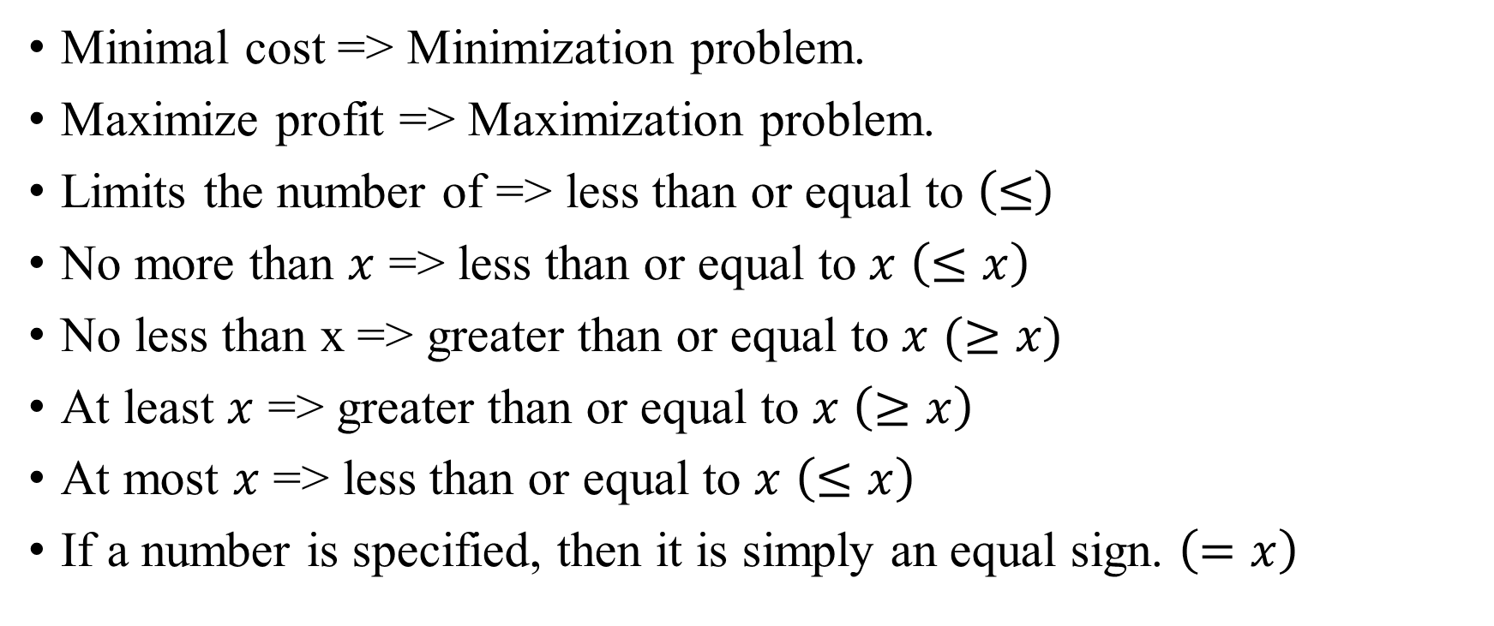
A list of words to pay attention to
Minimal cost => Minimization problem.
Maximize profit => Maximization problem.
Limits the number of => less than or equal to $\left(≤\right)$
No more than $x$ => less than or equal to $x$ $\left(≤x\right)$
No less than x => greater than or equal to $x$ $(≥x)$
At least $x$ => greater than or equal to $x$ $\left(≥x\right)$
At most $x$ => less than or equal to $x$ $\left(≤x\right)$
If a number is specified, then it is simply an equal sign. $\left(=x\right)$

Slide 22
Thank you for listening!

